Slide 1
Algorithms
Lecture #10
Dr.Sohail Aslam

Slide 2
Algorithm
Lecture #10
Sohail Aslam

Slide 3
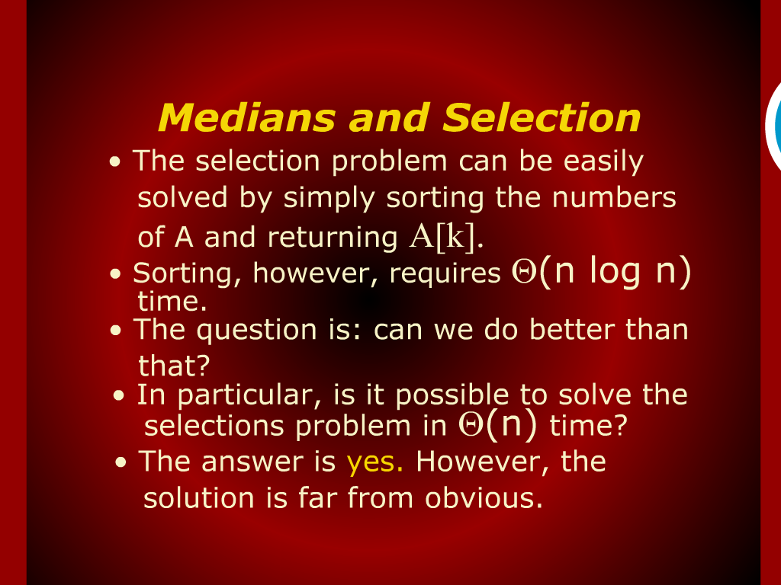
Medians and Selection

Slide 4
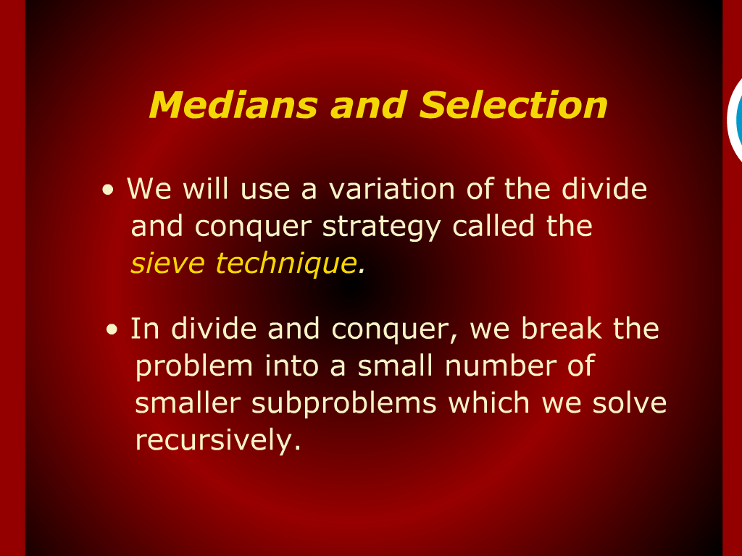
Medians and Selection

Slide 5
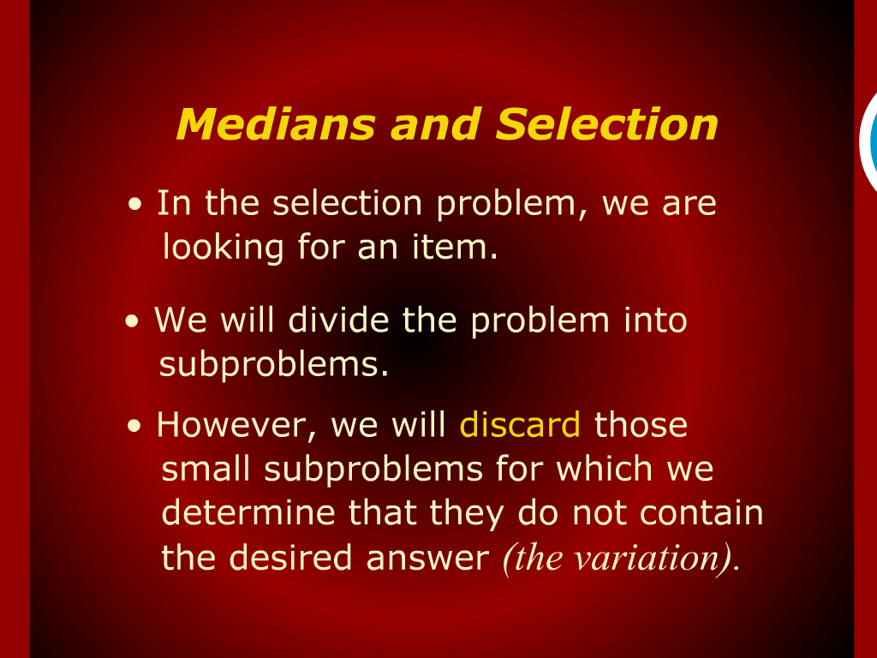
Medians and Selection

Slide 6
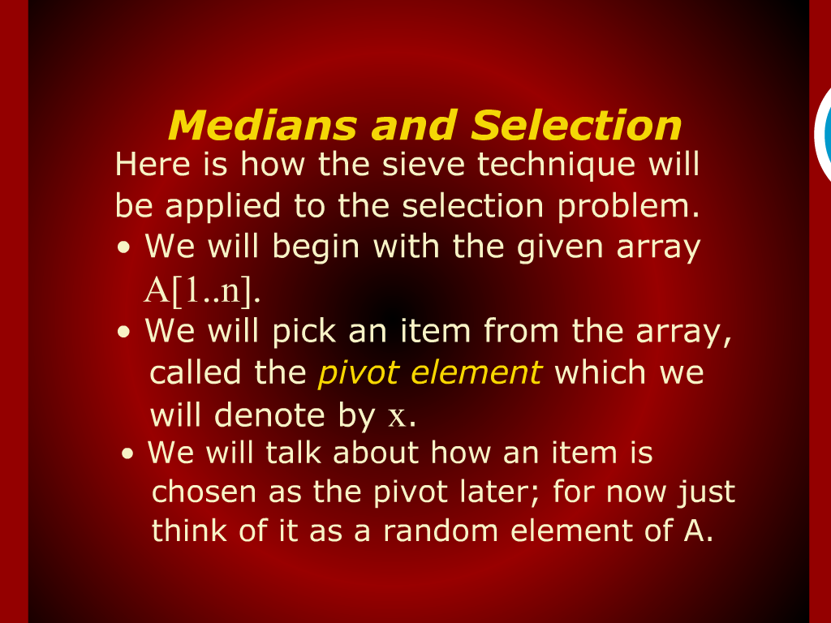
Medians and Selection

Slide 7
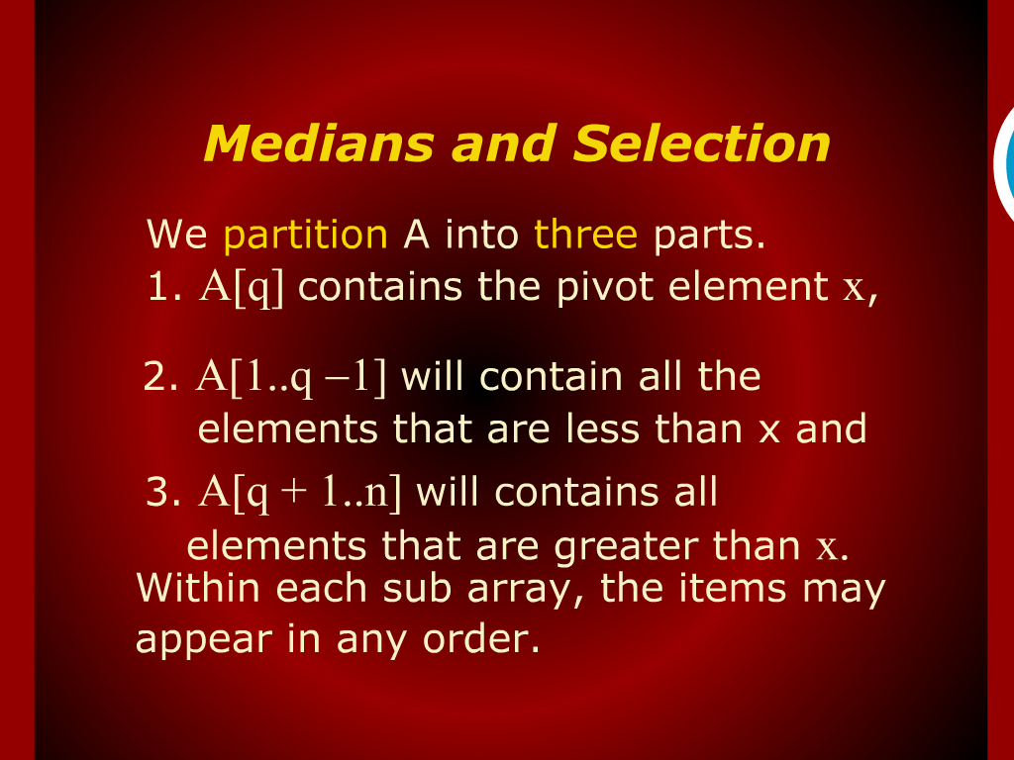
Medians and Selection

Slide 8
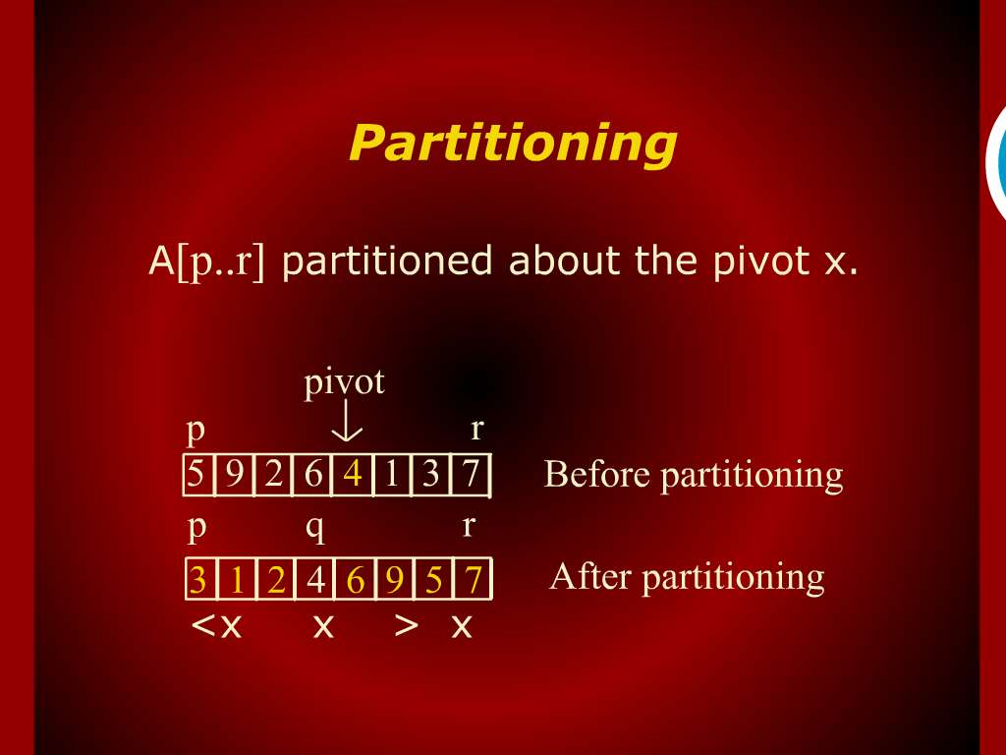
Partitioning

Slide 9
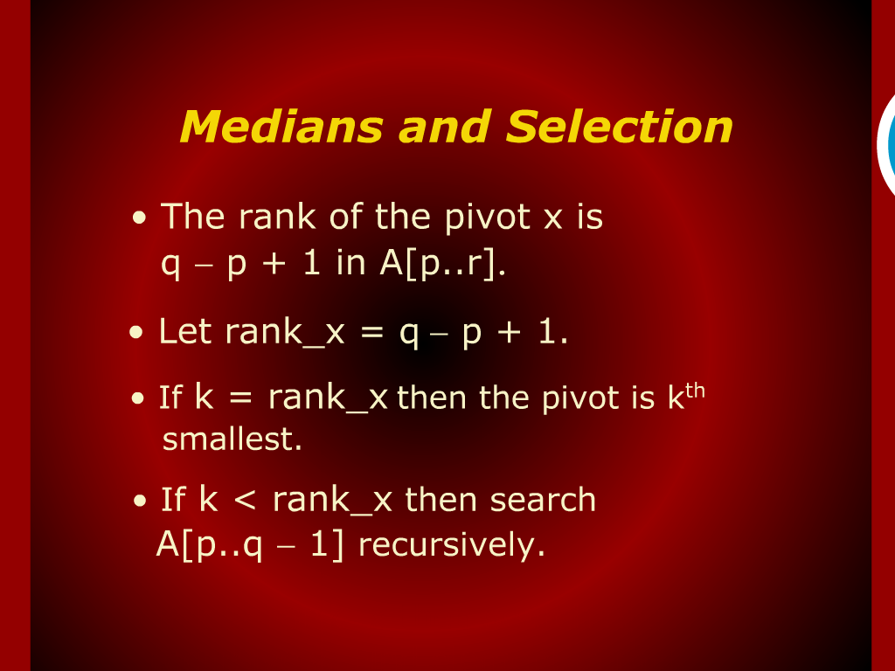
Medians and Selection

Slide 10
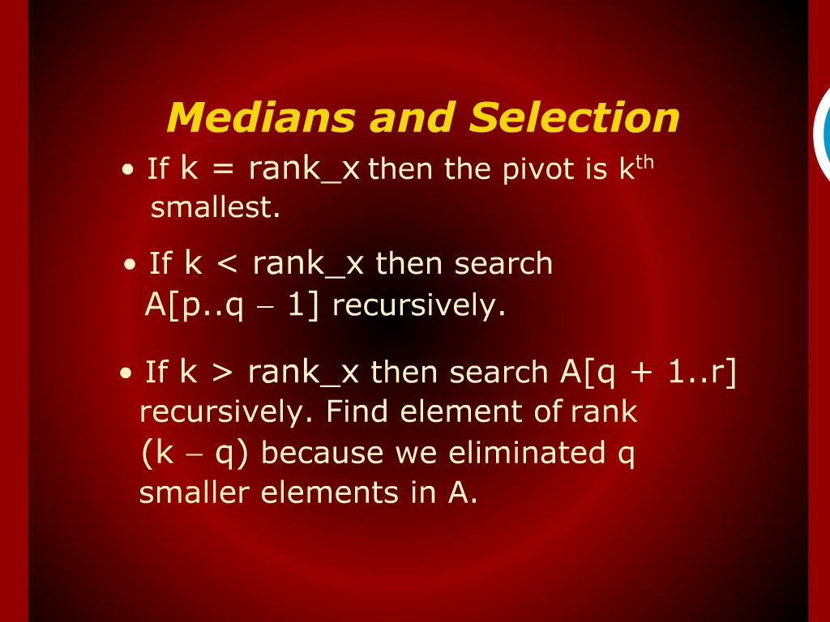
Medians and Selection

Slide 11
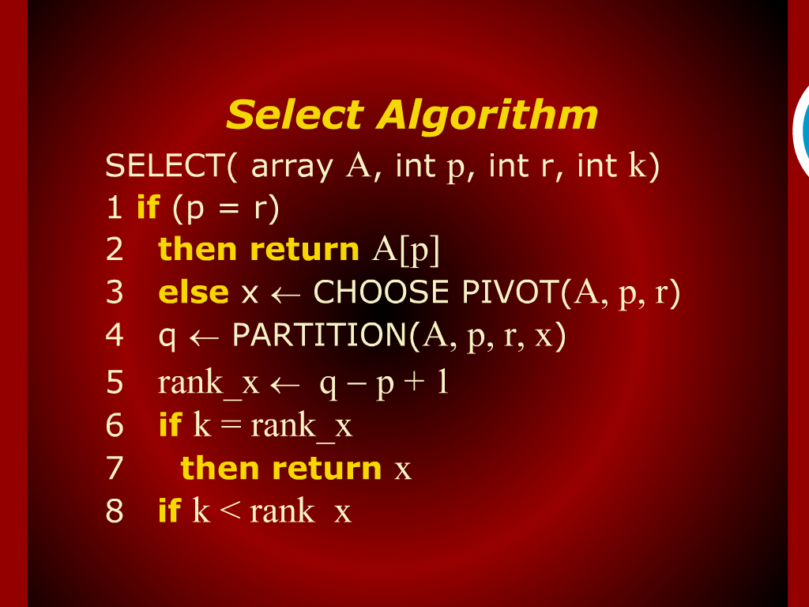
Select Algorithm

Slide 12
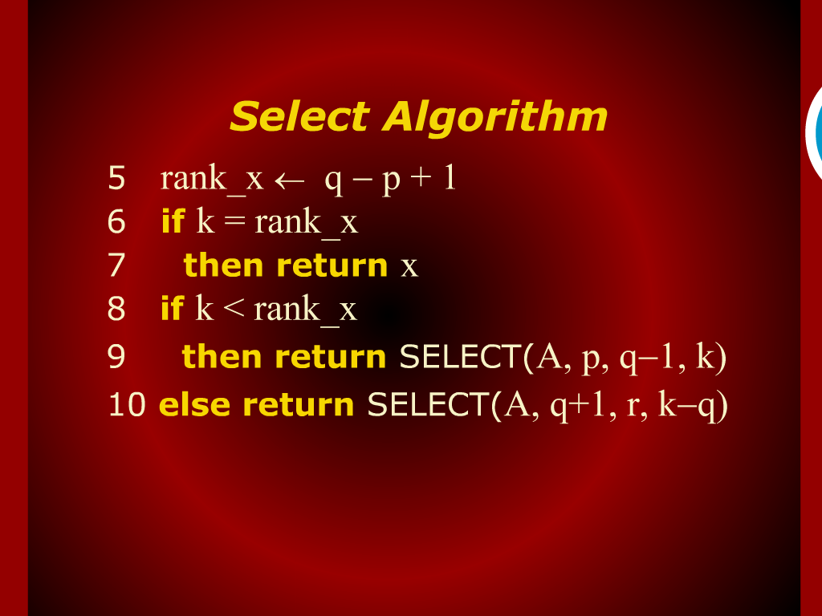
Select Algorithm

Slide 13
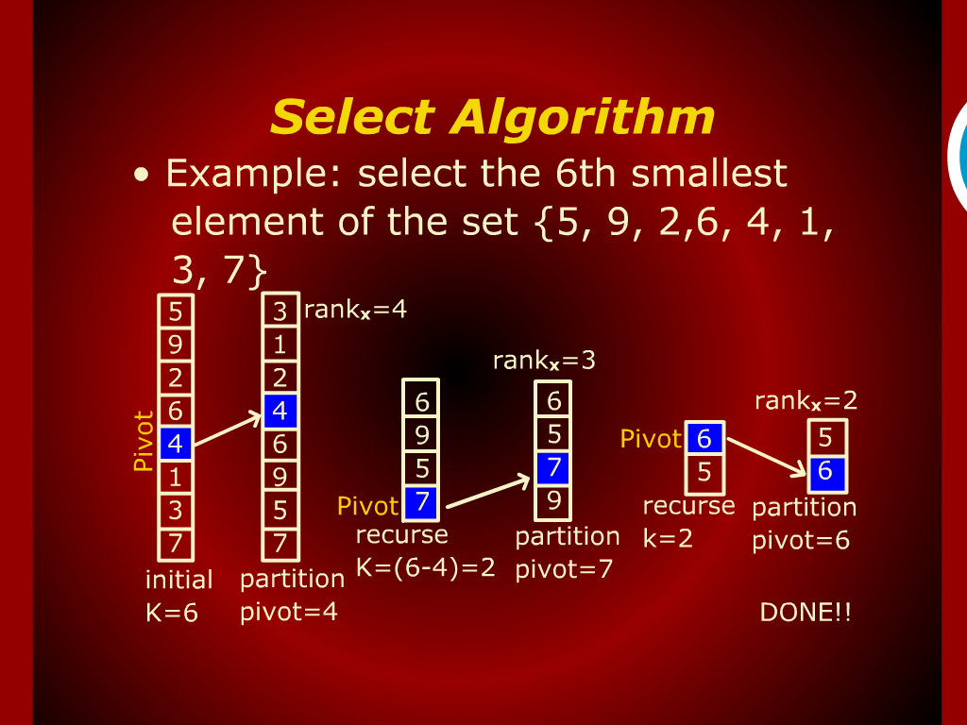
Select Algorithm

Slide 14
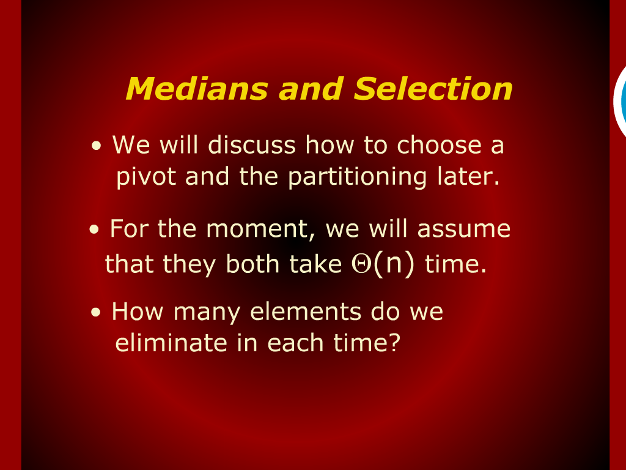
Medians and Selection

Slide 15
Steve Technique

Slide 16
Design
and
Analysis of Algorithm

